Slide 1
Inferential Statistics
Inferring about the population with the help of sample is called inferential statistics
Hypothesis Testing

Slide 2
Hypothesis – Assumption
Practical problem
Mathematical Problem
Mathematical Solution
Practical Solution

Slide 3
Null Hypo : H0 : All 100 laddus are Good
Alternate Hypo : H1 : All 100 laddus are bad
Accused
100 laddus
Population
Good
Bad
Guilty Innocent
H0 is TRUE
H0 is FALSE , H1 is True
Punish
Buy
Judge
Accept H0
We
Confidence Level (1-alpha) (.95,.90,.99)
TYPE II Error
Evidence
Release
Consumer’s risk (beta)
Sample(1)
Not Buy
Reject H0
TYPE I Error
Power of hypothesis Test
Producer’s risk
Significance Level (alpha)
(0.05, 0.10, 0.01)

Slide 4
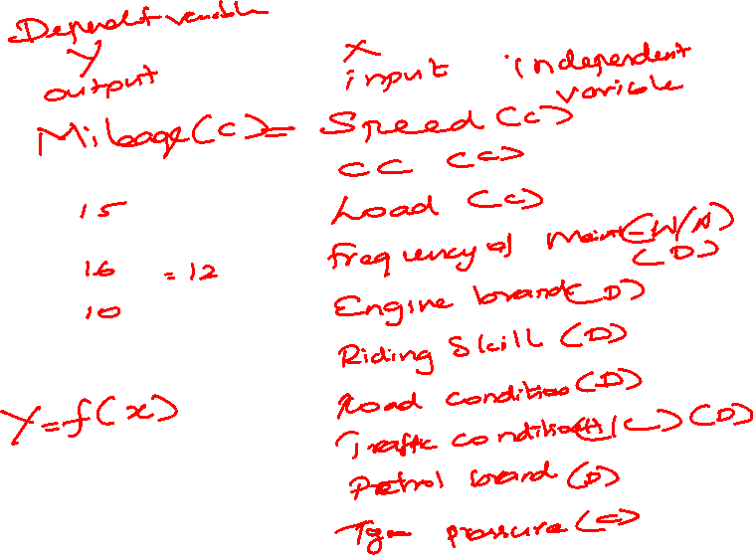
Step 1 : Identify X and Y and Its data type
Step 2 : Set alpha value
Step 3 : Select the Hypothesis Test
Step 4 : Frame Hypothesis
Step 5 : Perform Test
Step 6 : Find P value
Step 7 : Compare p value with alpha
Step 8 : Accept/ Reject Null Hypothesis
Step 9 : Conclusion
If p value is lower than alpha Reject Null
If p value is higher than alpha Accept null
P high Null fly
P low Null go

Slide 5
A financial analyst at a Financial institute wants to evaluate a recent credit card promotion. After this promotion, 500 cardholders were randomly selected. Half received an ad promoting a full waiver of interest rate on purchases made over the next three months, and half received a standard Christmas advertisement. Did the ad promoting full interest rate waiver, affects purchases?
Step1:
Y = amount of Purchases (C)
X = ad promotion (FIW/SCO) (D)
Step 8 : P value is low than alpha
Step 9 : Reject Null
Ad promotion affects the purchase
Step 2 : 0.05
Step 3 : 2 – sample t test ( y-C, X,D &2 )
Step 4 : Frame Hypothesis
H0 : X does not affect Y : muF = muS
H1 : X affect Y : muF != muS
Step 5 : Perform test
Step 6 : p value = 0.024
Step 7 : 0.024 | 0.05

Slide 6
A marketing organization outsources their back-office operations to three different suppliers. The contracts are up for renewal and the CMO wants to determine whether they should renew contracts with all suppliers or any specific supplier. CMO want to renew the contract of supplier with the least transaction time. CMO will renew all contracts if the performance of all suppliers is similar
Y – Transaction Time (C)
X – Supplier (A/B/C) (D)
Alpha = 0.05
One way ANOVA (Y- C & x- D (3 or more sample)
H0: X does not affect Y ( muA= mub = muC)
H1: X affect Y (muA!= mub != muC)
pvalue=0.103
P is high
Null Accepted
Conclusion : Suppliers doesn’t affect transaction time
All the Suppliers have equal transaction time
Renew All the Suppliers

Slide 7
An statistician wants to determine whether the monthly expenditure cost for families has changed from the previous year, when the mean cost per month was $300. The statistician randomly samples 28 families and records their expenditure costs for the current year.
Y – Expenditure Cost (C)
X – Year(Current year/ Pr year) (D)
Alpha = 0.05
1 sample t test
Ho: X doesn’t affect Y (muC = 300)
H1 : X affect Y (muC != 300)
Perform test
P value – 0.208
P high
Null Accepted
Expenditure cost is equal to previous year

Slide 8
Y Continuous and X Discrete
Comparing 1 Sample vs STD
Comparing 2 samples
Comparing 3 or more samples
Normality test
One sample t test
Normality test
Two sample t test
Normality test
One Way ANOVA

